Slide 1
GOAL:
Sparking Empowered Engagement
(SEE)

Slide 2
7 PHASES
Idea Generation
Exploring Personal Value Systems
“How To”
Refresher
Take Action
Reflection
Re-action

Slide 3


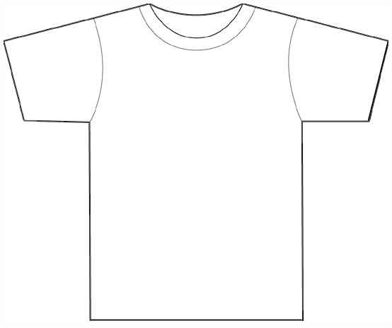


Express yourself

Slide 4
ACTION
Bring skills back to the community
REFLECTION →
Program evaluation to address challenges

Slide 5

IMPACT

