Slide 1
Promoting Social Responsibility Through Academic Networking
Unify campus resources
Integrate Core Commitments
Student and faculty networking
space

Slide 2
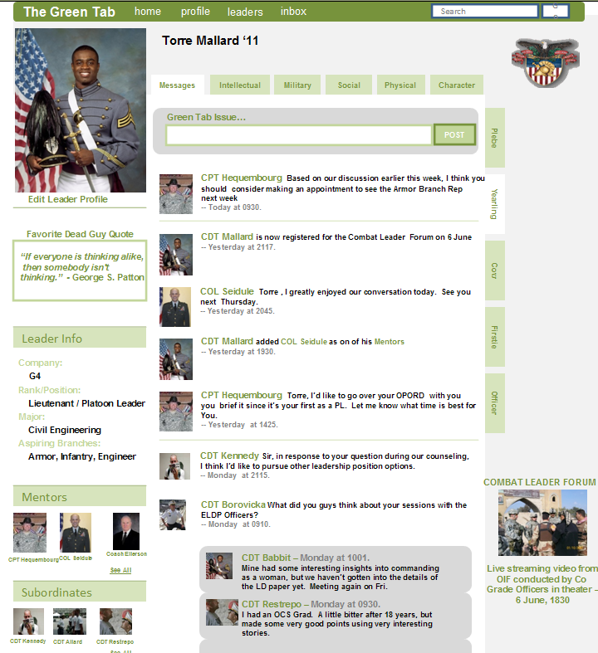
What does it look like?
Facebook format for familiarity and ease of use
Tabs for different sections
  Academic
  Community
  Character

Slide 3
Budget
$1500 advertising
$1000 use of Turnitin.com
$2000/year work study stipend for a student administrator

Slide 4
Change
Set new standard for personal and academic excellence
Strengthen relationship between Core Commitments and achievement
Encourage personal and community development

Slide 5
Lasting Impact
Maintained through student interest
Web committee
Faculty Support
Community Affiliation

